Slide 1
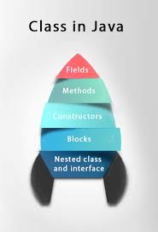
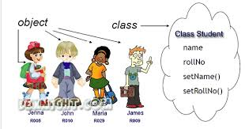
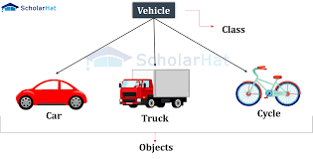
Defining a class in Java

Slide 2
Class – User Defined Data Type
We can think of the class as a sketch (prototype) of a house. It contains all the details about the floors, doors, windows, etc. Based on these descriptions we build the house. House is the object.
Since many houses can be made from the same description, we can create many objects from a class
class ClassName {
// fields are used to store data
// methods are used to perform some operations
}

Slide 3
Class – User Defined Data Type
Class : It is specifies the set of variables (fields) and the set of functions (methods) supported by a software unit of particular type.
class are the reference types and instances of class can be created using the new operator.
Instance variables : are the variables whose separate copy is created in every instance of the class. Instance variables decides the structure of the class.

Slide 4
Class – User Defined Data Type
Methods : are the ways in which interaction will be allowed with the instance of this class.these methods are always invoked on a target instance of the class.
Instance methods cannot be used without an instance. Methods can be overloaded.
Constructors: Used to initialize the instance variables.These are invoked on an instance whenever an instance is created using the new operator.It is used only with the new operator.

Slide 5
This keyword
this is keyword in java.it is used in a constructor to invoke the constructor of the same class in case of constructor overloading.
The keyword “this” followed by a list of parameters can be used to invoke another constructor of the same class.
this is only from within a constructor, it has to be the first statement in the consturctor.

Slide 6
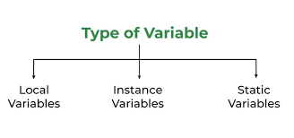
Class Static variable
Static variables : are known as class variables are not part of any instance of the class.There Is only one copy of these in the JVM, which comes into existence only when the class is loaded.These variables exist without depending on any instance of the class.Even if there are no instance of the class, the class variable can still exist.
Static methods: are also known as the class methods are not depend on any instance of the class, these methods is invoked using the class name

Slide 7
Static methods-Initializer block
These methods do not have the implicit current object called this, which is available in the non-static part of the class.
Initializer block: is used to define the activity that is required to be carried out whenever any instance is created for the class.There can be any number of intializer blocks in a class definition.This code is executed just before the

Slide 8
Class Initializer block
Any of the constructor code is executed.
Class initializer block: is used to initialize the class variables.This block is executed only once when the class is loaded, and similar to the initializer block in a class definition we can have any number of class initializer blocks.

Slide 9
Finalize method: When the garbage collector decides to deallocate any instance, it looks for a special methods in that class definition for the instance called finalize(), and would invoke just before deallocation.
It is not meant to be invoked from application.
In life of any instance finalize() is the last method invoked in the life of any instance of a class.

